Slide 1

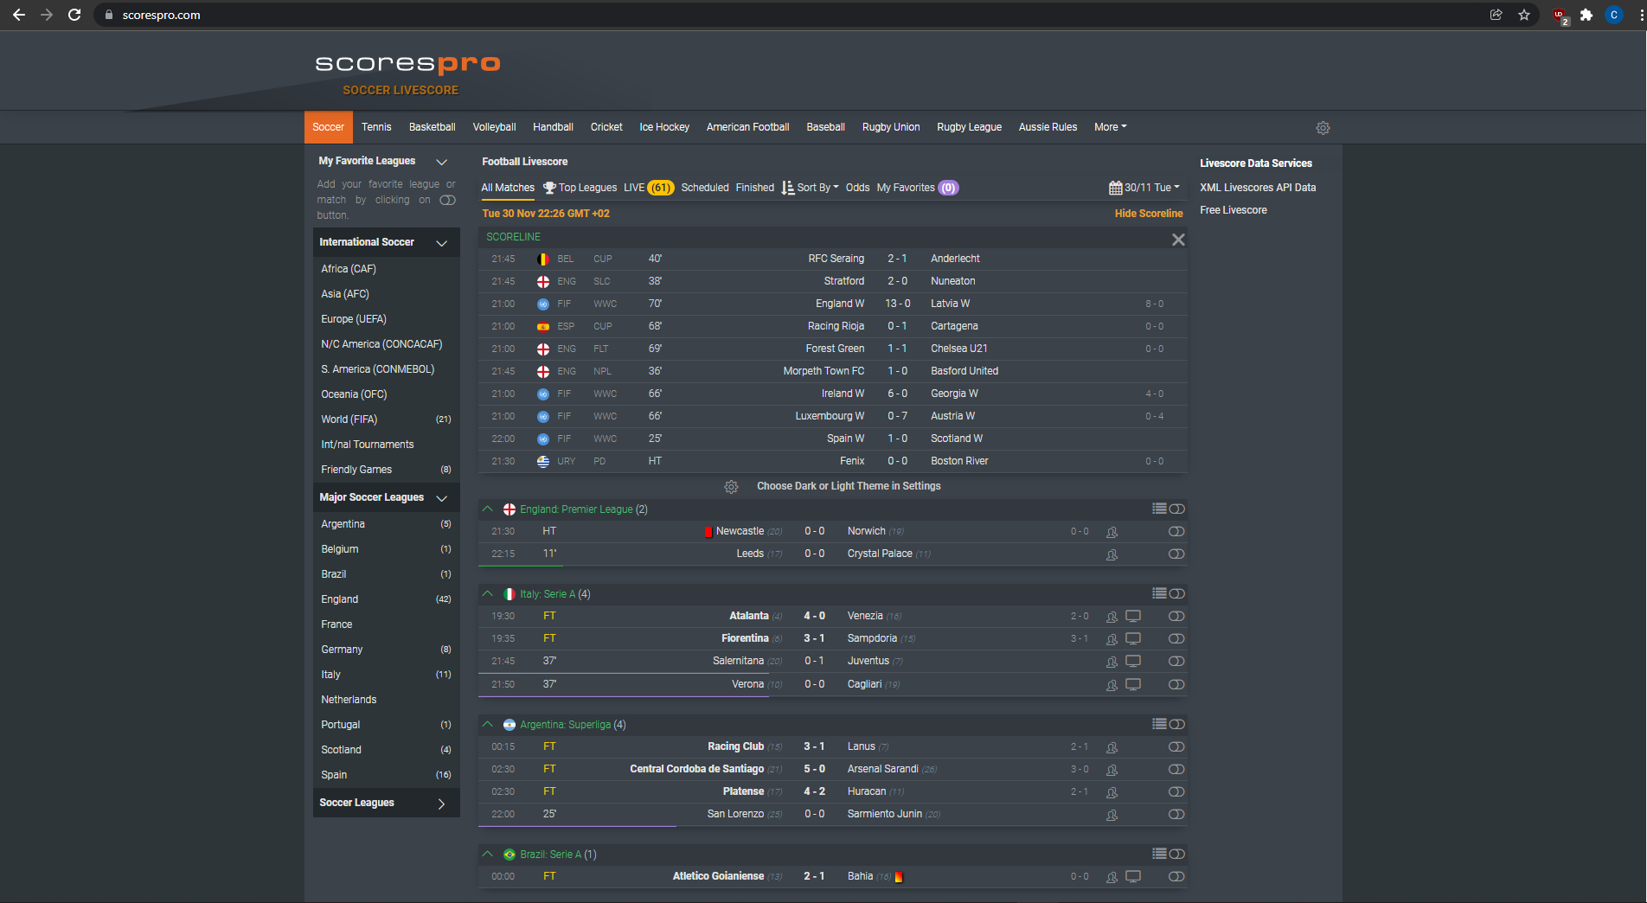
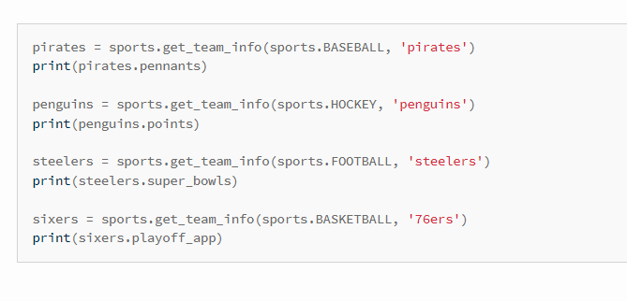
Sports Alert
Coder: Cameron Feldman
A program that allows a user to retrieve sports information such as scores for their favorite team

